Slide 1
UCB - CS189 Introduction to Machine Learning Fall 2015 Lecture 13: Linear Discriminant Analysis (LDA) and QDA
Isabelle Guyon
ChaLearn

Slide 2
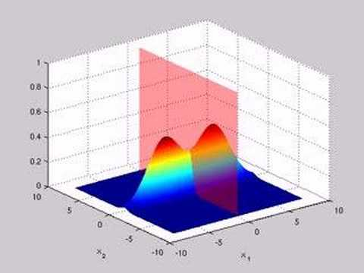
Come to my office hours… Wed 2:30-4:30 Soda 329
Last time: Gaussian classifier aka centroid method aka naïve Bayes aka Hebb’s rule revised

Slide 3
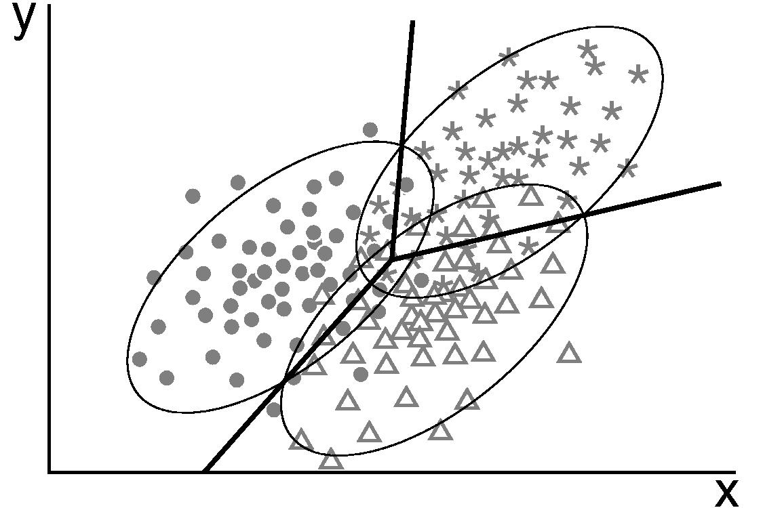
Come to my office hours… Wed 2:30-4:30 Soda 329
Today: LDA

Slide 4
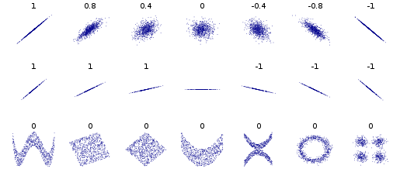
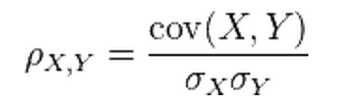
Math prerequisites Independence, covariance, correlation, and dot product
Independence: P(X, Y) = P(X)P(Y)
Mean:
μ_{x} = E(X)
Expected
Empirical
μ_{x} = (1/N) Σ_{k=1:N} x^{k}
Variance:
σ_{X}² = E[(X- μ_{x})²]
σ_{x}² = (1/N) Σ_{k=1:N} (x^{k}- μ_{x})²
Covariance:
Covariance:
σ_{XY} = E[(X- μ_{x})(Y- μ_{Y})]
σ_{XY} = (1/N) Σ_{k=1:N} (x^{k}- μ_{x})(y^{k}- μ_{Y})
Pearson correlation:
Pearson correlation:
σ_{xy}
σ_{xy}
Link to dot product:
E(X Y)
(1/N) x . y = (1/N) Σ_{k=1:N} x^{k} y^{k}

Slide 5
What could be X and Y?
X_{i}
X_{j}
Y
d features
X=[x^{k}_{i}]
data matrix
x_{i}
x_{j}
y =[y^{k}]
N samples
x^{k}
y^{k}
μ
μ_{i}
μ_{j}
Used for centering
f(x^{k}) = w.x^{k}
w

Slide 6
Outer product
X is a line random vector X= [X₁ X₂ ….. X_{i} ….. X_{d} ]
X_{i}
X_{j}
d features
X=[x^{k}_{i}]
data matrix
x_{i}
x_{j}
feature dim(N, 1)
N samples
x^{k}
sample dim(1, d)
Σ= E(X^{T}X) covariance matrix (if X has 0 mean), dim (d,d)
Σ= (1/N) X^{T}X outer product = empirical covariance matrix , dim (d,d)
Σ is positive semi-definite and has therefore a square root R= Σ^{(1/2)}
Φ = XR⁻¹ is the “whitened data” Φ^{T}Φ = Ι

Slide 7
Data transforms
x^{k}= [x^{k}₁ x^{k}₂ ….. x^{k}_{i} ….. x^{k}_{d} ] is a line of the data matrix X.
Mean:
Centering: subtracting the mean of the features.
μ = (1/N) Σ_{k=1:N} x^{k}
ξ(x^{k}) = x^{k}- μ
Variance:
σ_{i}² = (1/N) Σ_{k=1:N} (x_{i}^{k}- μ_{i})²
Standardizing or “sphering”: subtracting the mean and dividing by the standard deviation (component-wise).
Covariance:
φ(x^{k}) = (x^{k}- μ) ./ σ
φ_{i}(x^{k}) = (x_{i}^{k}- μ_{i})/σ_{i}
σ_{ij} = (1/N) Σ_{k=1:N} (x_{i}^{k}- μ_{i})(x_{j}^{k}- μ_{j})
(d,d) covariance matrix:
Whitening: multiplying by the square root of the inverse coveriance matrix.
Σ = σ_{ij} = (1/N) Ξ^{T}Ξ
(N, d) centered data matrix:
Ξ = [ξ_{i}(x^{k})] = [x_{i}^{k}- μ_{i}]
Φ = Ξ Σ^{-1/2}
(N, d) = (N, d) (d, d)

Slide 8
Math prerequisites Ellipses
An ellipse in its principal axes is a flattened circle:
circle: σ₁=σ₂
ellipse: σ₁≠σ₂
x₂
x₁ - μ₁ = σ₁ cos θ
x₂ - μ₂ = σ₂ sin θ
x₁ - μ₁ x₂ - μ₂
σ₁ σ₂
σ₂
θ
(μ₁, μ₂)
σ₁
x₁
2
2
+
=1
x₂
σ₂
θ
(μ₁, μ₂)
σ₁
x₁

Slide 9
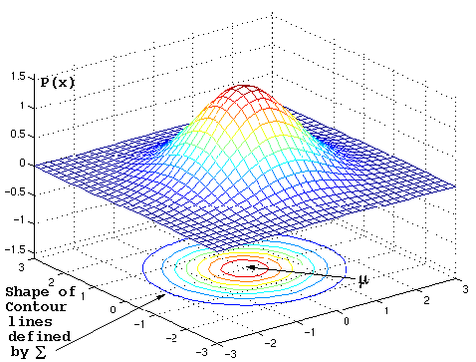
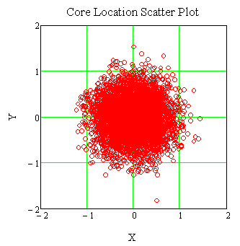
Isotropic Gaussian ~exp(-ǁx-μǁ²/2σ²)
Contours = circles:
exp(-ǁx-μǁ²/2σ²)=cte
x₁ - μ₁ x₂ - μ₂
σ₁ σ₂
σ₁=σ₂
2
2
+
=cte
Source: https://www.byclb.com/TR/Tutorials/neural_networks/ch4_1.htm

Slide 10
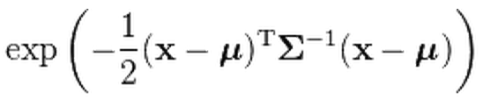
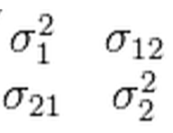
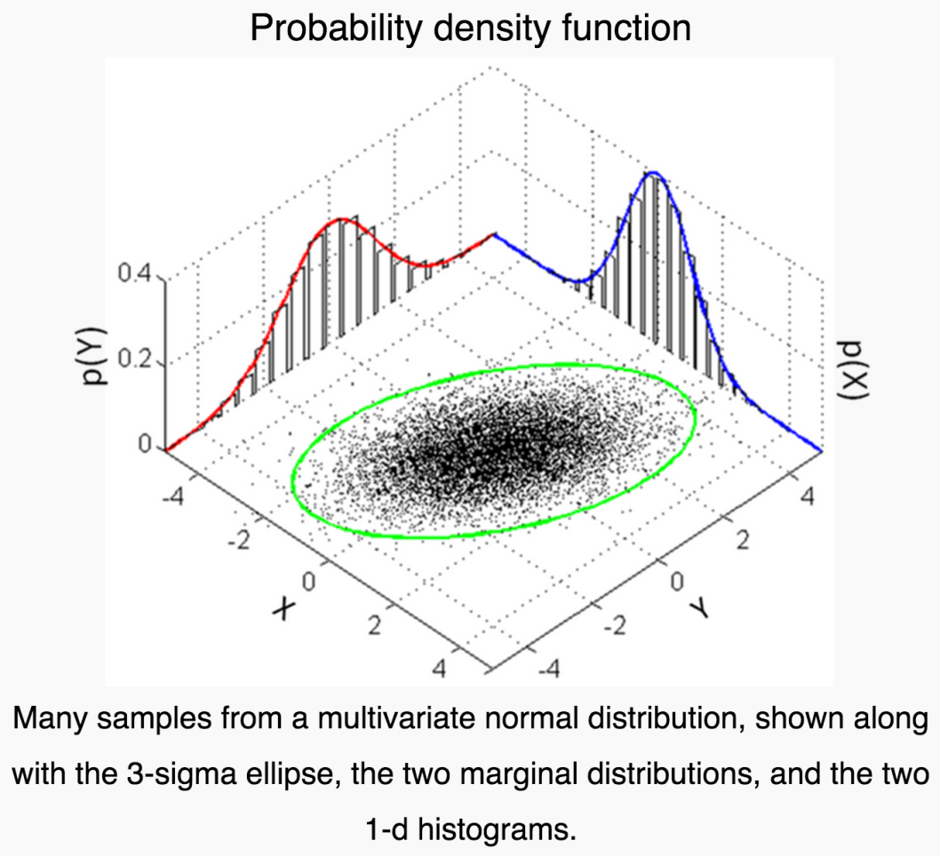
Multivariate Gaussian
T
~
=exp(-(1/2)φφ^{T})
(1, d) (d,d) (d, 1)
Σ =
Contours in the principal axes:
φ₁ – μ_{φ1} φ₂ - μ_{φ2}
σ_{φ1} σ_{φ2}
2
2
+
=cte
Source: Wikipedia

Slide 11
How to get the principal axes?
X = [x_{i}^{k}] is our data matrix (N lines = samples, d columns = feature).
Assume the sample means μ_{i} = (1/N) Σ_{k} x_{i}^{k} were subtracted from columns x_{i} already.
Then X^{T}X is the (d, d) covariance matrix of the features (up to a factor N).
We can diagonalize it as: Σ = X^{T}X = US²U^{T}
With U and orthogonal matrix of column eigenvectors, such that U^{T}U = I.
S² is a diagonal matrix of positive eigenvalues s_{i}².
Matrix R = USU^{T} = Σ^{1/2} is the square root of X^{T}X: R² = X^{T}X.
So to obtain a diagonal covariance matrix S, one just needs to apply matrix U to rotate the axes (and get Φ^{T}Φ = S², that is a diagonal covariance matrix):
Φ = XU
or apply R⁻¹ for data whitening (and get Φ^{T}Φ = Ι, that is a diagonal covariance
matrix, with all the feature variances equal to 1):
Φ = XR⁻¹ = X Σ^{-1/2}

Slide 12
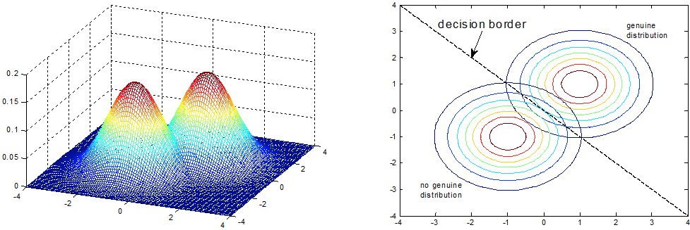
Gaussian classifier ŷ =argmax_{y} P(Y=y|X=x) ~ P(Y=y) P(X=x|Y=y) ~ P(Y=y) exp(-ǁx-μ^{[y]}ǁ²/2σ²)
Source: http://www.intechopen.com/source/html/17742/media/image25.png
f(x) =0
μ^{[1]}
y
μ^{[0]}
f(x) = (μ^{[1]} – μ^{[0]}) • x + b b = (μ^{[0]2} – μ^{[1]2})/2+log(N₁/N₀)
w

Slide 13
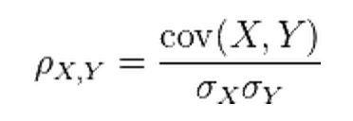
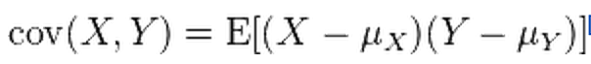
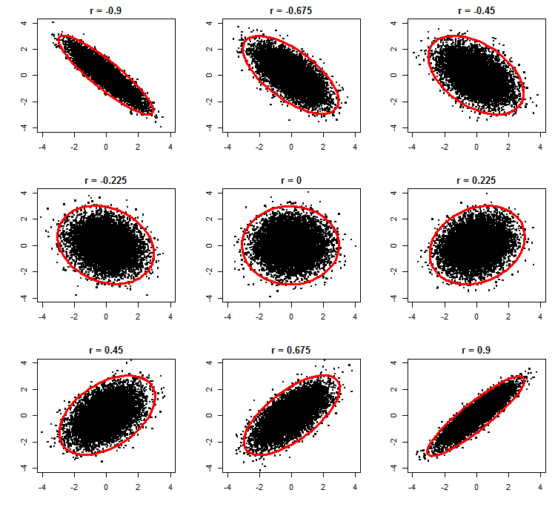
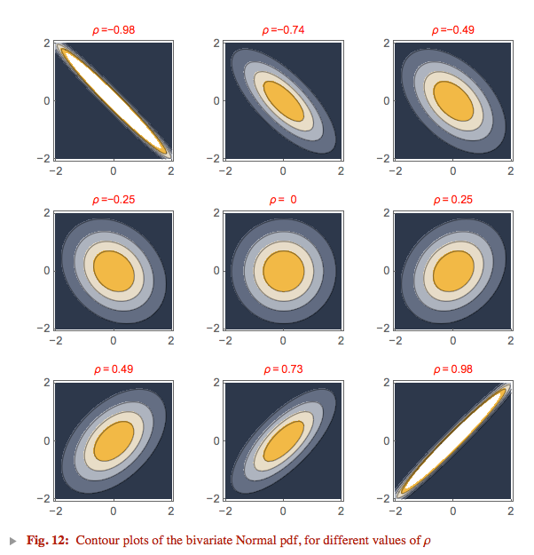
Multivariate Gaussian and covariance
Independence: P(X, Y)=P(X)P(Y)
Zero correlation or covariance

Slide 14
Different σ_{i}
x₂
σ₂
σ₁
σ₂
σ₁
x₁
Axes re-scaled: data “sphering”.
x₂/σ₁
f(x) = ∑_{i} [(μ_{i}^{[1]} – μ_{i}^{[0]})/σ_{i}²] x_{i} + b
f(x) = ∑_{i} [μ_{i}^{[1]}/σ_{i} – μ_{i}^{[0]}/σ_{i}] x_{i}/σ_{i} + b
f(x) = ∑_{i} [ μ_{i}^{[1]}’ – μ_{i}^{[0]}’] x’_{i} + b
x₁/σ₁

Slide 15
Class conditional independence
P(Y=y|X=x) ~ P(Y=y) P(X=x|Y=y)
Class prior: P(Y=y)
x₂ = life length
y = gender
Female
y
N(0, σ)
N(0, σ)
μ₁
μ₂
Data likelihood
P(X=x|Y=y)
x₁ = Chocolate
x₂ = Life length
Male
x₁ = chocolate intake
P(X=x|Y=y) ~ exp(-ǁx-μǁ²/2σ²)
= exp(- ∑_{i=1:N} (x_{i}-μ_{i})²/2σ²)
= Π_{i=1:N} exp(-(x_{i}-μ)²/2σ²)
~ Π_{i=1:N} P(X_{i}|Y)
x₁ | x₂ | y

Slide 16
Class conditional independence
P(Y=y|X=x) ~ P(Y=y) P(X=x|Y=y)
Class prior: P(Y=y)
x₂ = life length
y = gender
y
Female
N(0, σ₁)
N(0, σ₂)
μ₁
μ₂
Data likelihood
P(X=x|Y=y)
x₁ = Chocolate
x₂ = Life length
Male
x₁ = chocolate intake
P(X=x|Y=y) ~ exp(- ∑_{i=1:N} (x_{i}-μ_{i})²/2σ_{i}²)
= Π_{i=1:N} exp(-(x_{i}-μ)²/2σ_{i}²)
~ Π_{i=1:N} P(X_{i}|Y)
x₁ | x₂ | y

Slide 17
Class conditional independence
P(Y=y|X=x) ~ P(Y=y) P(X=x|Y=y)
Class prior: P(Y=y)
x₂ = life length
y = gender
Female
y
N(0, σ₁)
N(0, σ₂)
μ₁
μ₂
Data likelihood
P(X=x|Y=y)
x₁ = Chocolate
x₂ = Life length
Male
x₁ = chocolate intake
P(X=x|Y=y) ~ exp(- ∑_{i=1:N} (x_{i}-μ_{i})²/2σ_{i}²)
= Π_{i=1:N} exp(-(x_{i}-μ)²/2σ_{i}²)
~ Π_{i=1:N} P(X_{i}|Y)
x₁ | x₂ | y

Slide 18
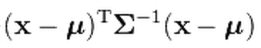
No independence
P(Y=y|X=x) ~ P(Y=y) P(X=x|Y=y)
Class prior: P(Y=y)
x₂ = life length
y = gender
Female
y
μ₁
μ₂
Data likelihood
P(X=x|Y=y)
x₁ = Chocolate
x₂ = Life length
Male
x₁ = chocolate intake
N(0, Σ)
x₁ | x₂ | y
^{[y]}
^{[y]}
P(X=x|Y=y) ~

Slide 19
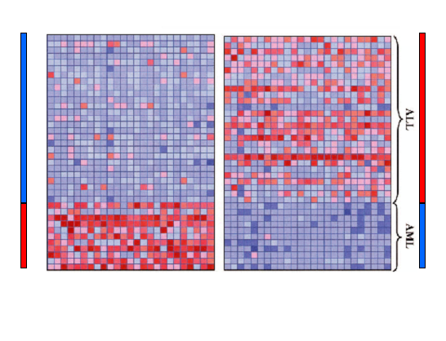
Data sphering
d
-1
+1
N
μ_{i}^{[0]}
-
μ_{i}^{[1]}
+1
-1
{-y_{i}}
{y_{i}}
Golub et al, Science Vol 286:15 Oct. 1999
μ_{i}^{[1]} - μ_{i}^{[0]}
-1
σ_{i} ≅ ½ (σ_{i}^{[0]} + σ_{i}^{[1]} )
w_{i} =
σ_{i}²
Rank features according to “signal-to-noise” ratio:
S2N = | σ_{i} w_{i} | ≅ | corrcoef | ∼ | x • y |
For “balanced classes and after “standardization” x ←(x-μ_{x})/σ_{x}
σ_{i}^{[0]}
σ_{i}^{[1]}

Slide 20
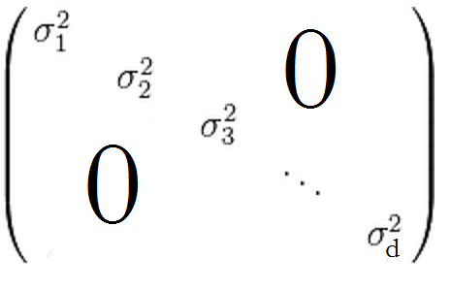
Matrix notations
For the examples of a given class y, within class variance: σ_{i}² = E[(x_{i} - μ_{i}^{[y]})²] (same for all classes).
Independence assumption: x_{i} | x_{j} | y ⇒
no within class covariance: E[(x_{i} - μ_{i}^{[y]})( x_{j} - μ_{j}^{[y]})] = 0
Diagonal covariance matrix: Σ =
Trivial to invert, for each class y:
= ∑_{i=1:d} (x_{i} – μ_{i}^{[y]})²/σ_{i}²
P(X=x|Y=y) ~
^{[y]}
^{[y]}
T
(1, d) (d,d) (d, 1)
T
^{[y]}
^{[y]}

Slide 21
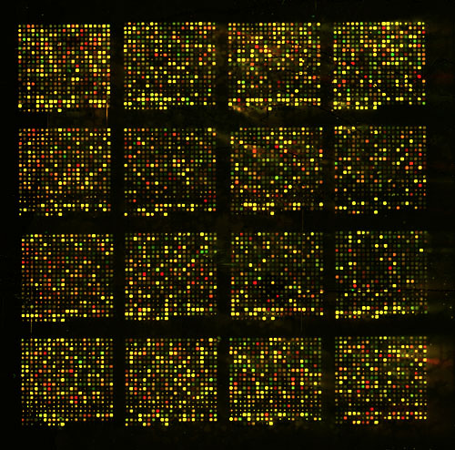
Correlated noise
Source: http://www.uv.es/~arandaa/2002-07-03_WO-vs-WA.jpg

Slide 22
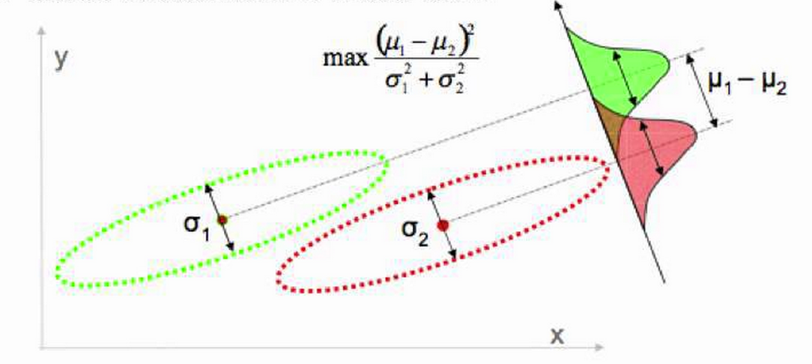
Linear Discriminant Analysis (LDA)
Rotate input space.
Find the direction that maximizes the ratio of the between class variance over the within class variance.
Source: Victor Lavrenko

Slide 23
This is still a linear classifier (assumes identical covariance matrices)

Slide 24
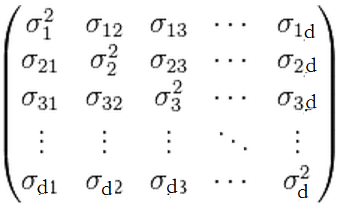
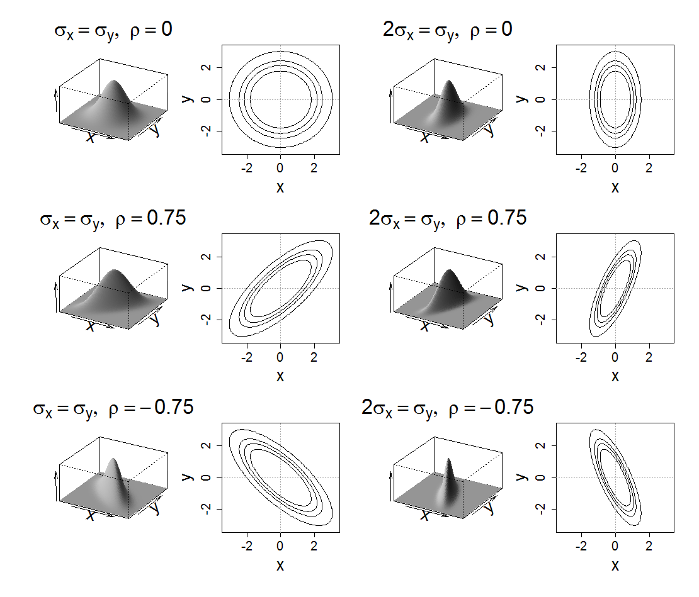
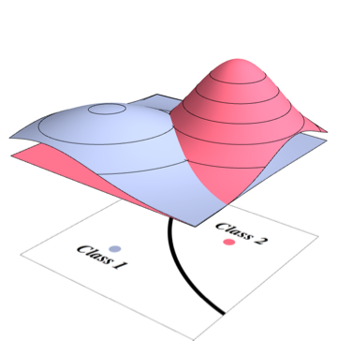
General case
^{[y]}
^{[y]}
T
P(X=x|Y=y) ~
(1, d) (d,d) (d, 1)
Σ =
Not necessarily
a linear classifier!
Source: http://www.stat.cmu.edu/

Slide 25
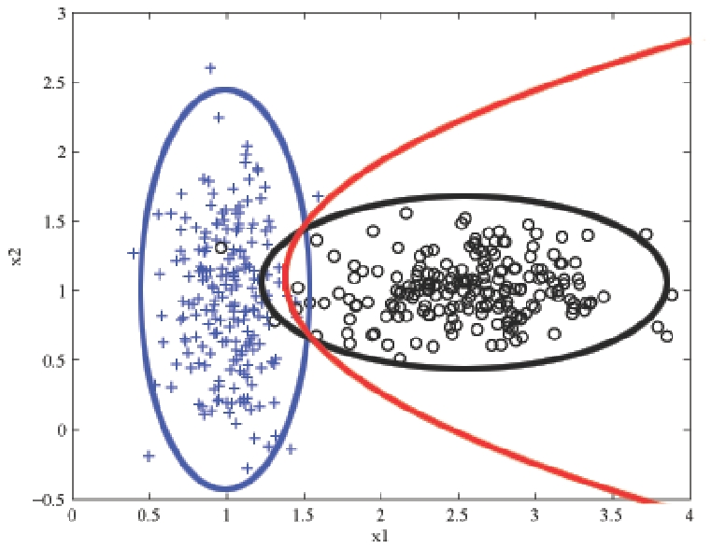
QDA
http://learning.cis.upenn.edu/cis520_fall2009/index.php?n=Lectures.NaiveBayes

Slide 26
Multiclass LDA

Slide 27
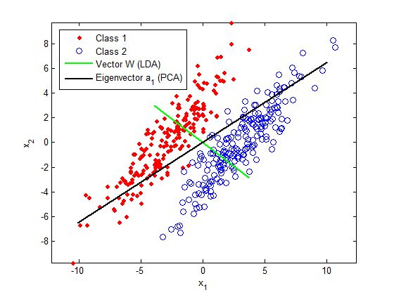
LDA and PCA
Source: www.intechopen.com
Apply whitening in both case with Φ = X Σ^{-1/2}
PCA: Σ is the TOTAL covariance matrix.
LDA: Σ is the POOLED WITHIN CLASS covariance matrix.
Then use the centroid method.

Slide 28
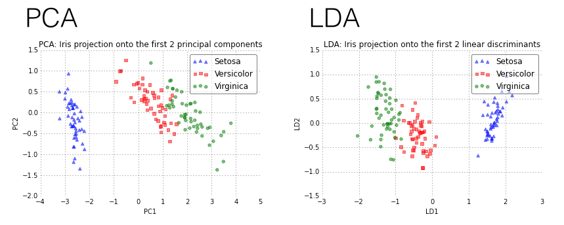
LDA and PCA (continued)
http://sebastianraschka.com/Images_old/2014_intro_supervised_learning/iris_pca_lda.png

Slide 29
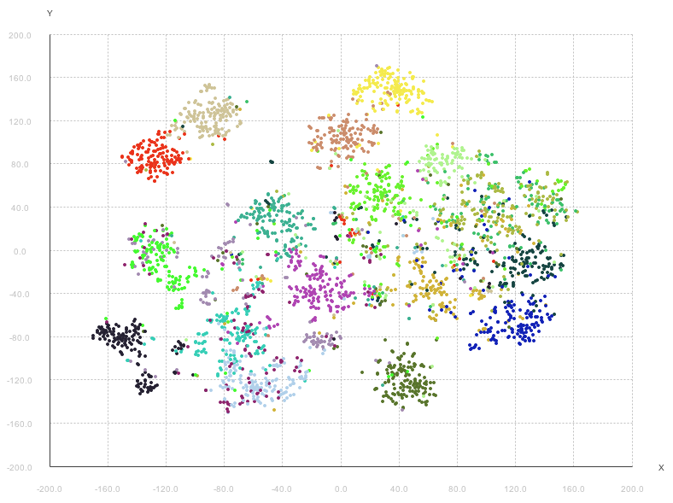
LDA for data visualization 20 Newsgroups
Source http://lejon.github.io/

Slide 30
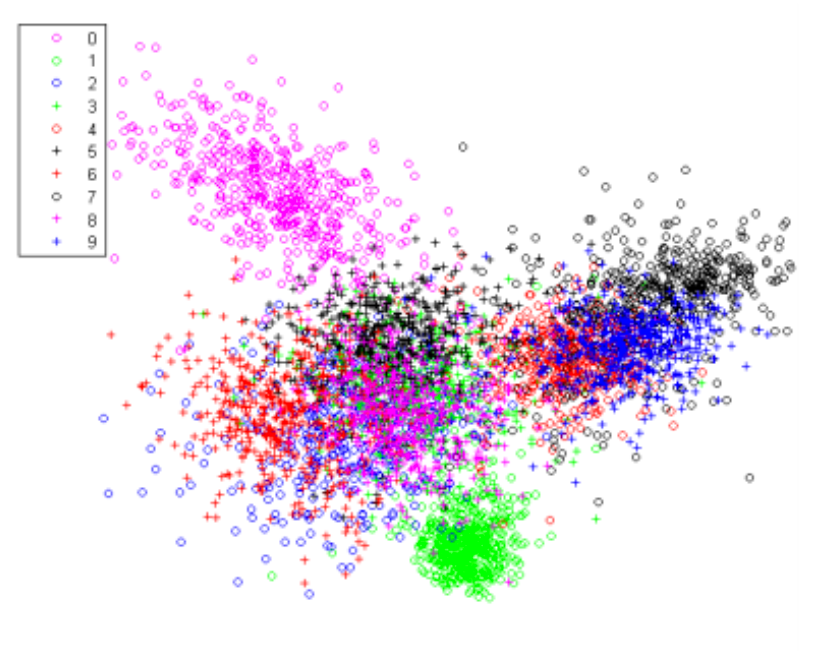
LDA for data visualization MNIST
Source: Wang et al. 2014 Generalized Autoencoder

Slide 31
Shrinkage (comparison with ridge regression)
Remember capacity control: Monitor C/N. C = d_{eff}
Minimize ǁwǁ²: this boils down for regression and SVM to adding a small value λ>0 to X^{T}X!
Do the same for LDA before inverting Σ= X^{T}X.
Σ ← Σ+ λI
Then whitening: Φ = X Σ^{-1/2}
Compare with ridge regression: f(x) = x . w^{T}
w^{T} = (X^{T}X)⁻¹ X^{T} y = X⁺y
Whitening: Φ = X (X^{T}X)^{-1/2} is the whitened data. Φ⁺ = Φ^{T} (Φ^{T} Φ = I)
φ = x (X^{T}X)^{-1/2}
In Φ-space, w^{T} = Φ^{T} y
f(x) = φ . w^{T}
LDA does the same thing, with target values 1/N₁ and -1/N₀ and using the pooled within class covariance matrix.
Model family | m models | Linear (d feat.) | Kernel method | SVM
Capacity | ≤ log m | ≤ d+1 | ≤ N | ≤ Nsv

Slide 32
How do ridge regression and regularized LDA control capacity?
For f(x) = w.x the VC dimension is C = d (the dimension of input space).
R_{reg} = RSS + λ ǁ w ǁ² RSS = ǁ Xw^{T} –y ǁ²
= wX^{T}Xw^{T} –2wX^{T}y +y^{T}y
Gradient: ∇_{w}R = 2 (X^{T}Xw^{T} – X^{T}y)
Hessian: H = 2X^{T}X
w₂
w₁

Slide 33
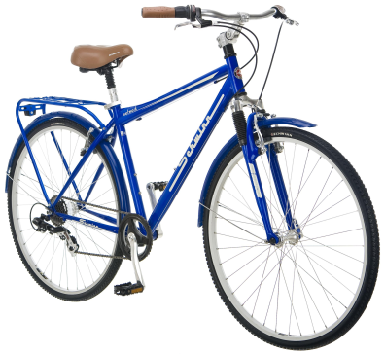
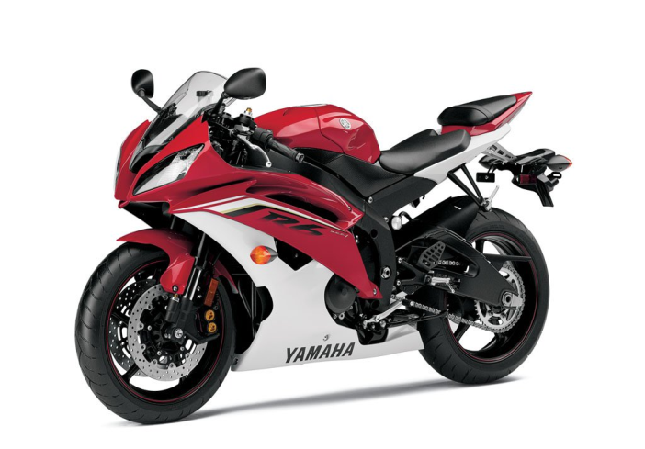
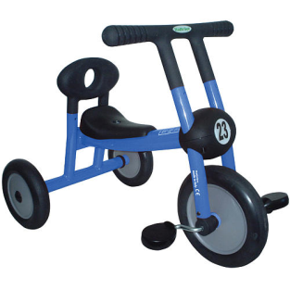
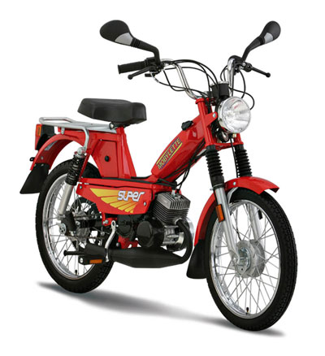
Generative models
You are here
Mixture models
LDA
Gaussian
processes
Naïve Bayes

Slide 34
Summary
LDA is a generalization of the Gaussian classifier for cases in which the input variables are not statistically independent, but all classes have the same covariance matrix Σ.
Once we rotate input space into the “principal axes” of Σ and rescale by the eigen values, LDA is like the isotropic Gaussian classifier, a.k.a. centroid method.
PCA and ridge regression use the covariance matrix of all the data. LDA uses the “pooled” within class covariance.
Two-class LDA is also called Fisher’s linear discriminant and is similar to least square regression with 1/N₁ and -1/N₀ target values.
LDA is useful for multi-class classification and data visualization. Other classifiers have multi-class versions.
LDA and logistic regression estimate P(Y=y|X=x) in different ways.

Slide 35
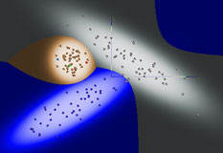
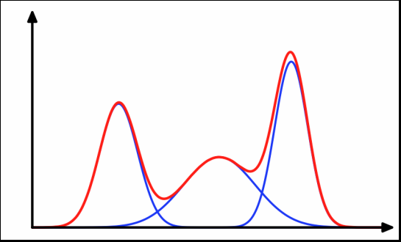
Come to my office hours… Wed 2:30-4:30 Soda 329
Next time: Mixture models

